Slide 1
Toward the Design of a Low Cost, Adaptive Hearing Aid
Investigators:
Kayla-Jade Butkow and Kelvin da Silva
Presented by:

Slide 2
Hearing Loss
Affects 5% of the global population
Causes
Age
Disease
Trauma
Decreased quality of life
Social isolation
Stigmatization

Slide 3
The Solution – Hearing Aid
Compensatory amplification
Correcting an individual’s hearing deficits
Applied based on an audiogram
Directionality
Amplifying sounds in particular directions – currently direction of highest SNR
Attenuating sounds in other directions
Cost of commercial hearing aid ~2000$

Slide 4
Objectives
Development of a low cost hearing aid
Functionality:
Amplifying specific frequency bands according to a person’s audiogram
User tuneable directionality (novelty)
Done in the form of:
Software simulation
Hardware proof of concept

Slide 5
System Block Diagram

Slide 6
Simulated vs Hardware Hearing Aid
Property | Simulation | Hardware
Number of microphones | 10 | 4
Device Bandwidth | 0.25–8 kHz | 2.8-3.5 kHz and 5.6-7 kHz
Filter Order | 14 | 2
Filter Bandwidth | 1/3 Octave | 1/3 Octave
Types of filters | Butterworth FIR bandpass | Butterworth bandpass
Number of filters | 16 per microphone | 2 per microphone
Number of steerable angles | 19 (10° increments) | 5 (0°, 60°, 90°, 120°, 180°)
Real time data acquisition | No | Yes

Slide 7
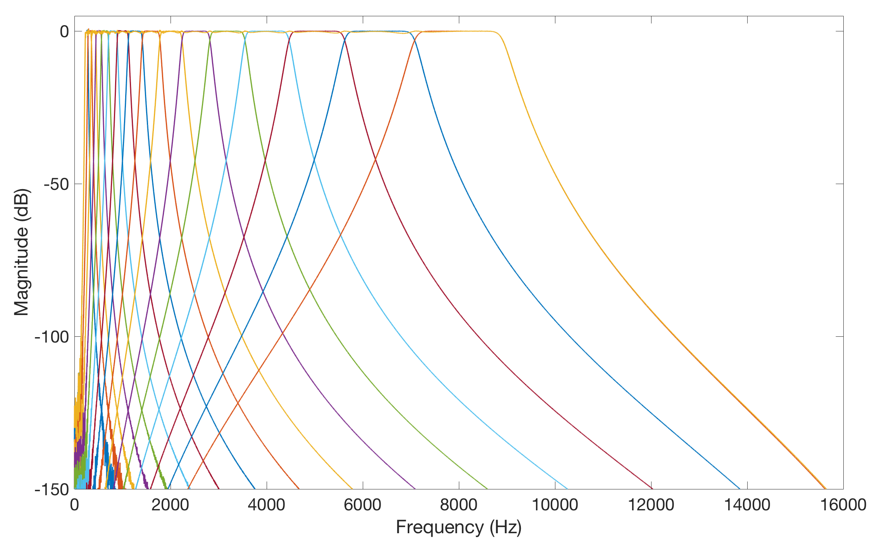
Compensatory Amplification
Audiogram matching: requires amplification of individual frequency bands
Notes:
Independent amplification
Band-by-band basis
Audiogram matching
Requires interpolation of audiogram
Unique for an individual

Slide 8
Directionality
Amplification in a user specified direction
Delay-and-sum beamforming
Source

Slide 9
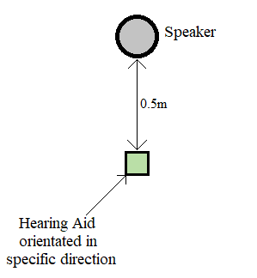
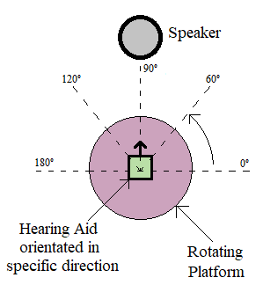
Testing
Compensatory gain
Directionality

Slide 10
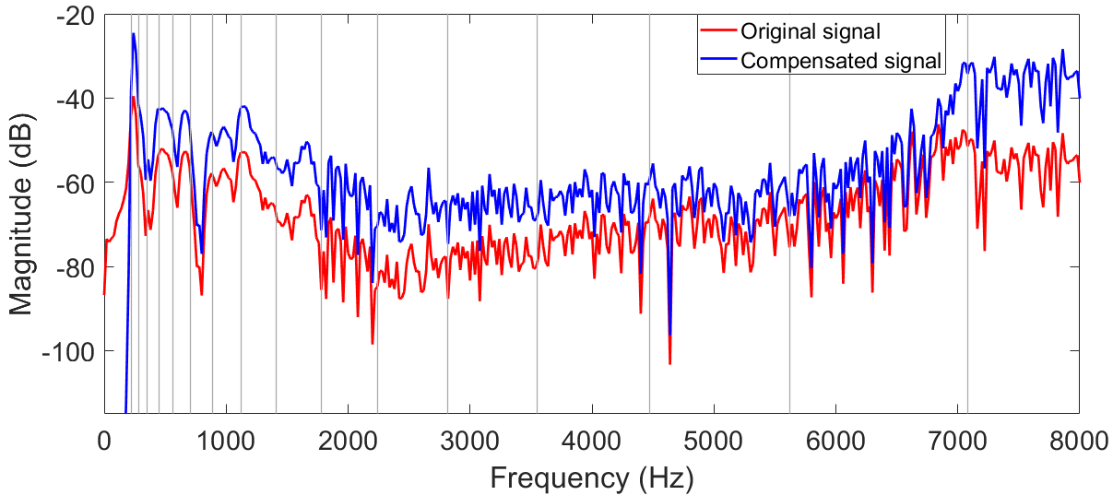
Simulation Results: Amplification
Matched to an audiogram
Average error per frequency band: 1.41%

Slide 11
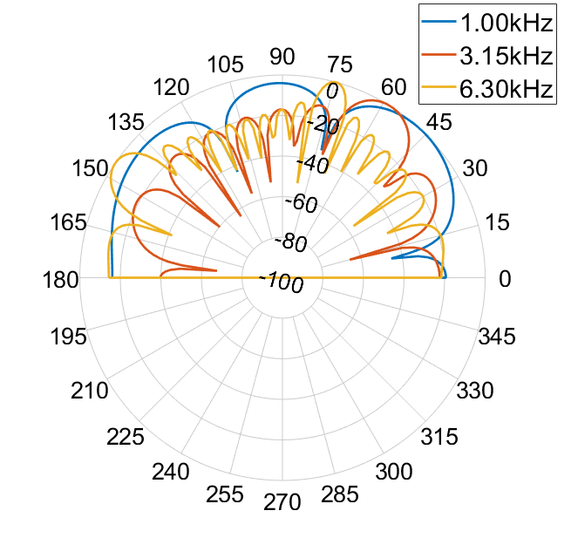
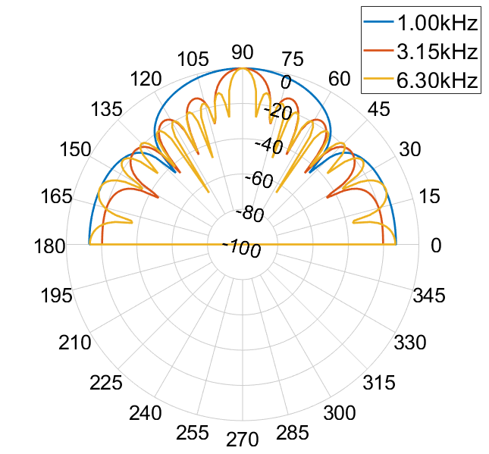
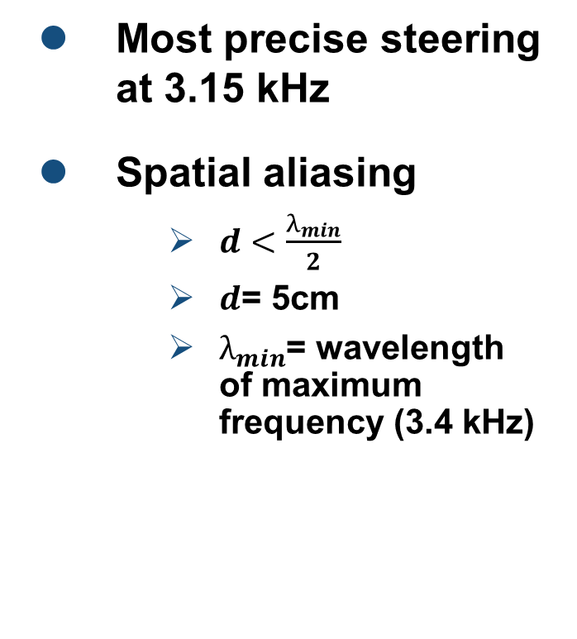
Simulation Results: Directionality
Most precise steering at 3.15 kHz
Spatial aliasing
$d<\frac{λ_{min}}{2}$
$d$= 5cm
$λ_{min}$= wavelength of maximum frequency (3.4 kHz)
60°
90°

Slide 12
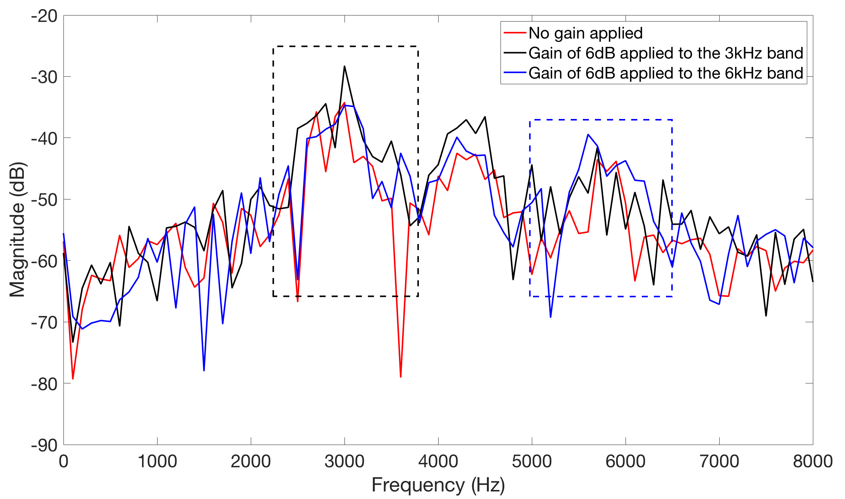
Hardware Results: Amplification
Total cost: $100
Input sound frequency: 3.15 kHz
Error caused by interaction of stop-bands
Notes:
Effect of amplifying one band is seen across the frequency spectrum- due to the order of the filter

Slide 13
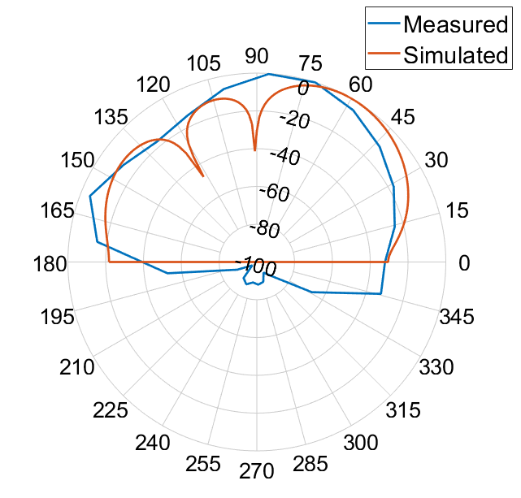
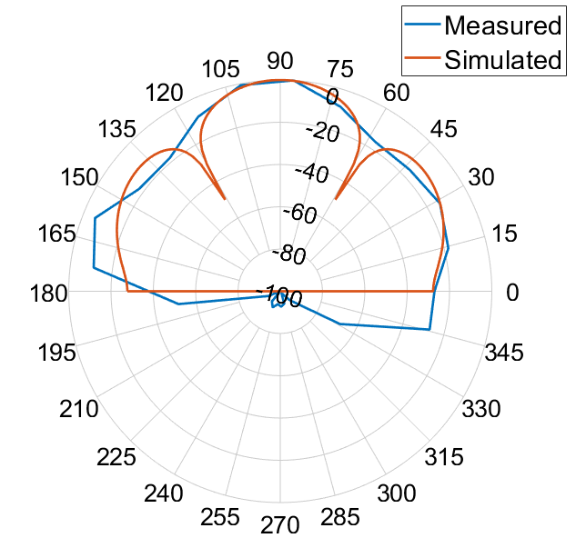
Hardware Results: Directionality
Most accurate at 90°
No time delay
Increased error in other directions
Integer number of sample shifts
60°
90°

Slide 14
System Error Analysis
Compensatory Amplification | Applied Frequency (kHz) | Frequency Band (kHz) | Error (%)
 | 3.15 | 2.82 - 3.55 | 0.81
 | 6.30 | 2.82 - 3.55 | 15.34
 | 3.15 | 5.62 - 7.08 | 19.56
 | 6.30 | 5.62 - 7.08 | 3.67
Directionality | Dial Angle (°) | Average Error (%)
 | 0 | 46.6
 | 60 | 30.7
 | 90 | 12.7
 | 120 | 22.7
 | 180 | 51.7
 | Omni-directional | 42.7
Notes:
Large omni error due to mics

Slide 15
Future Work
Higher quality omni-directional microphones
Integrated circuit chip
Pre-processing of the audio signals
Embedding circuitry into headphones
Reduce the size of the device
Make the device more user friendly

Slide 16
Conclusion
Objectives and specifications have been met
Low cost – $100
Full hearing aid simulation
Compensatory amplification
Steerable directionality
Concepts proven in hardware

Slide 17
References
[1] L. Tiete et al. “Detecting Laterality and Nasality in Speech with the Use of a Multi-Channel recorder.” Sensors (Basel, Switzerland), vol. 14, pp. 1918-1949, 02 2014.

Slide 18
Questions?

